Slide 1
State Modeling
UNIT - 2

Slide 2
Introduction
A state model describes the sequences of operations that occur in response to external stimuli.
As opposed to what the operations do, what they operate on, or how they are implemented.
Changes to objects and their relationships over time should be examined.
A state model consists of multiple state diagrams, one for each class with temporal behavior that is important to an application.
A state diagram relates events and states.
Events represent external stimuli
States represent values of (attributes) object.

Slide 3
Events (1)
An event is an occurrence at a point of time.
Examples:
User depresses left button
Flight 123 departs from Amman
Power turned on
Alarm set
Paper tray becomes empty
Events corresponds to verb in the past tense or the onset of some condition.
By definition an event happens instantaneously. The time at which an event occurs is an implicit attribute of the event.

Slide 4
Events (2)
One event may logically precede or follow another, or the two events are unrelated. Events that are causally unrelated are said to be concurrent.
Events include error conditions as well as normal occurrences.
Examples of error events:
Motor jammed
Transaction aborted
Timeout
There are several kinds of events. The most common are:
Signal event
Change event
Time event

Slide 5
Signal Events (1)
A signal is a one-way transmission of information from one object to another object.
It is different from a function call that returns a value
An object sending a signal to another object may expect a reply, but the reply is a separate signal under the control to the second object, which may or may not chose to send it.
A signal event is the event of sending or receiving a signal.
In general we are more concerned about the receipt of a signal because it causes effects in the receiving object.
Difference between signal and signal event: the first one is a message between object, the second one is an occurrence in time.

Slide 6
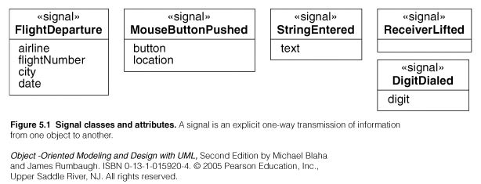
Signal Events (2)
Signal classes and Attributes:

Slide 7
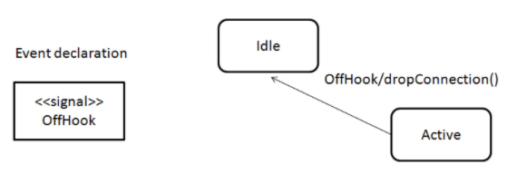
SIGNAL CLASS

Slide 8
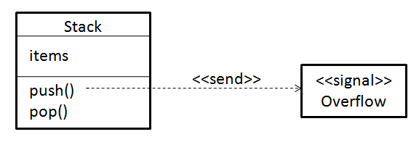

Slide 9
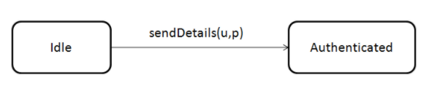
CALL EVENT

Slide 10
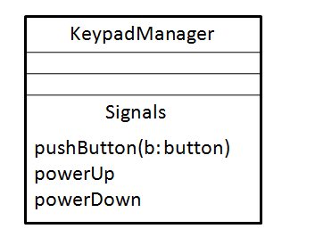

Slide 11
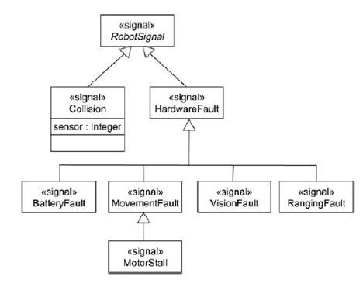

Slide 12
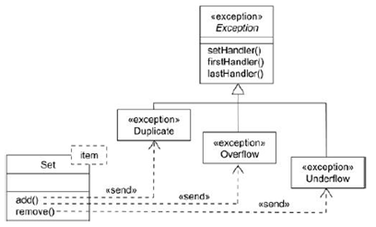

Slide 13
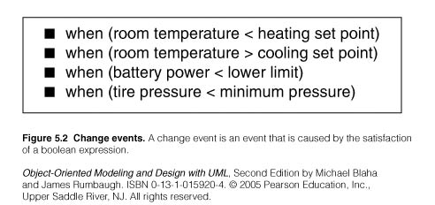
Change Event
A change event is an event that is caused by the satisfaction of a Boolean expression.
The intent of a change event is that the expression is continually tested and whenever the expression changes from false to true the event happens. (an implementation would not continuously check a change event)
Examples:

Slide 14
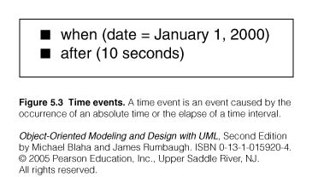
Time event
A time event is an event caused by the occurrence of an absolute tie or the elapse of a time interval.
Examples:

Slide 15
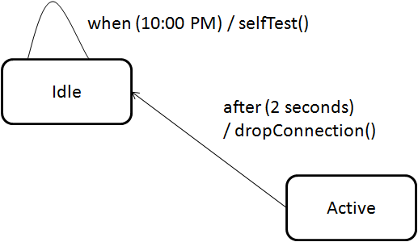

Slide 16
States
A state is an abstraction of the values and the links of an object.
Sets of values and links are grouped together into a state according to the gross behavior of objects.
Example: The state of an bank is either solvent or insolvent, depending on whether its assets exceed its liabilities.
States often correspond to:
verbs with a suffix ‘ing’: waiting, dialing..
Or the duration of some condition: powered, below freezing.

Slide 17
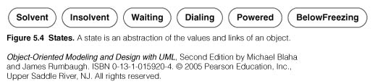
States
Notation:
The objects in a class have a finite number of possible states. One or possibly larger number.
Each object can only be in one state at time. Objects may parade through one to more states in their lifetime
A state specifies the response of an object to input events.
The response may include the invocation of a behavior or a change of state.

Slide 18
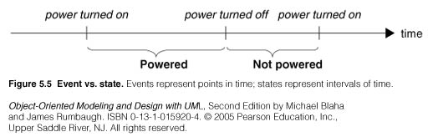
States
Event versus State:
Both events and states depend on the level of abstraction

Slide 19
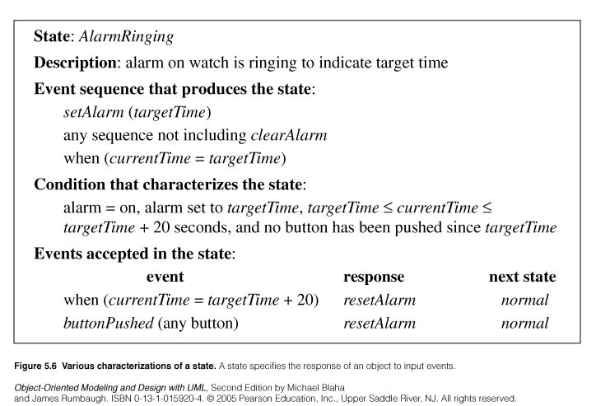
State
States may be characterized in various ways.
Here one way to characterize states:

Slide 20
Transitions and Conditions
A transition is an instantaneous change from one state to another.for eg:-when a called phone is aswered,the phone line transitions from the Ringing state to Connected state.
The transition is said to fire upon the change from the source state to the target state. Usually the origin and target states are different but may be the same.
A transition occurs when its event occurs, unless an optional guard condition causes the event to be ignored.
A guard condition is a boolean expression that must be true in order for a transition to occur.
The choice of next state depends on both the source state and the event received.

Slide 21
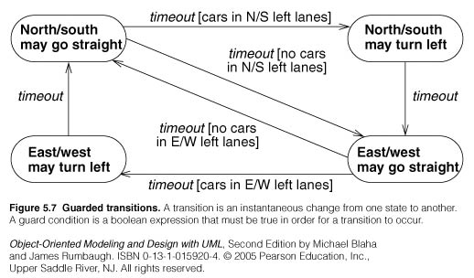
Transitions and conditions

Slide 22
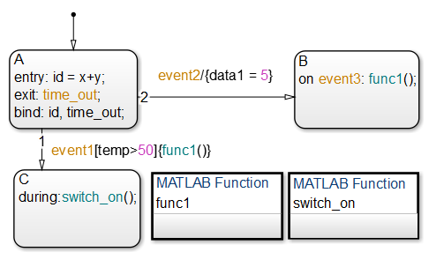

Slide 23
State Diagram
A state diagram is a graph whose nodes are states and whose directed arcs are transitions between states.
A state diagram specifies or describes the state sequence caused by event sequences.
State names must be unique within the scope of the state diagram.
All objects in a class execute the state diagram for that class.
The class state diagram models the common behavior of the class objects.

Slide 24
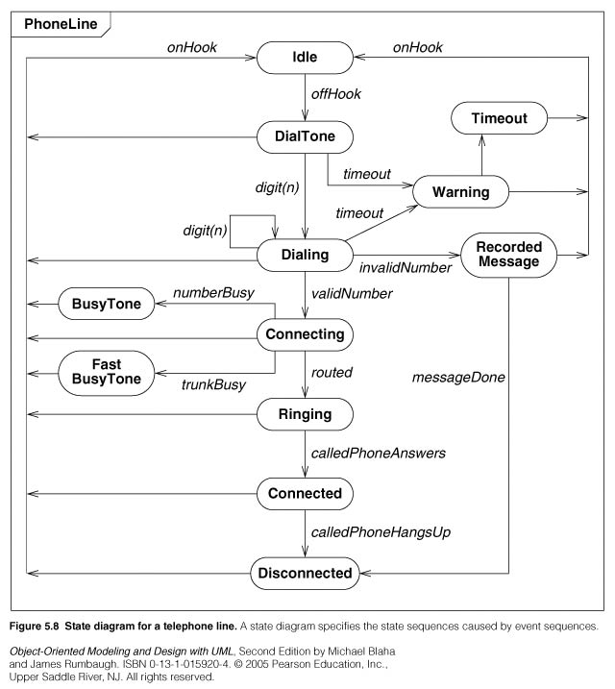
State diagram example

Slide 25
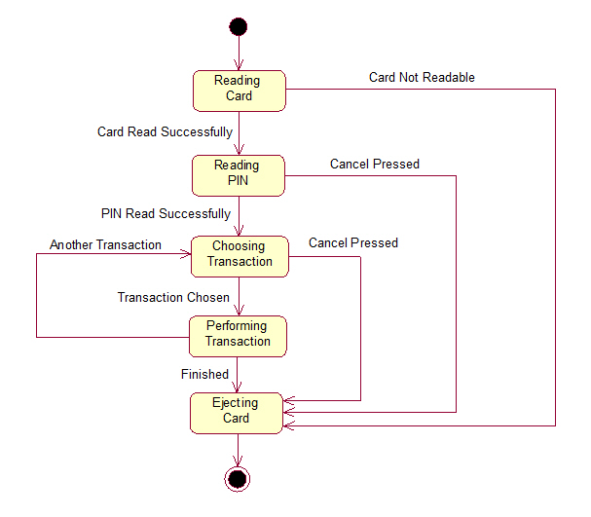
ATM Machine

Slide 26
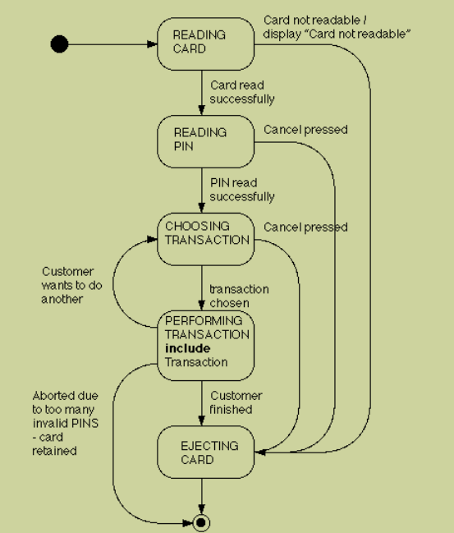
ATM STATE DIAGRAM

Slide 27
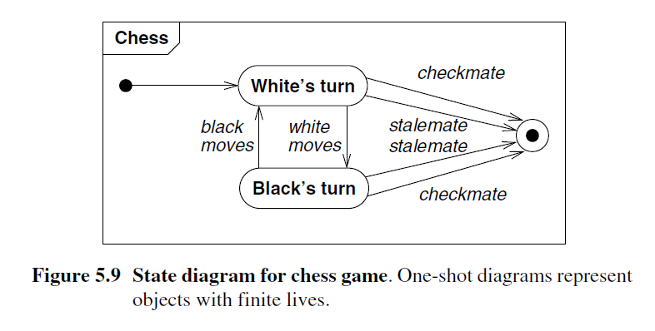
One-shot state diagrams

Slide 28
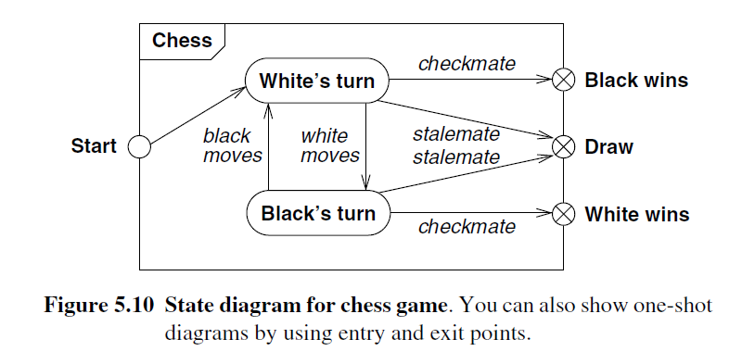

Slide 29
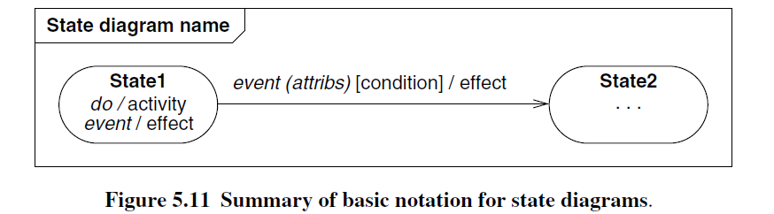

Slide 30
State diagram behavior : 1.Activity Effects
An activity is behavior that can be executed in response to an event.
An activity can be performed upon a transition, upon the entry to or exit from a state or upon some event within a state.

Slide 31
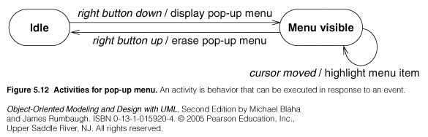
Examples

Slide 32
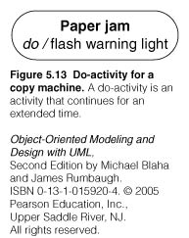
2. Do- Activities :Example

Slide 33
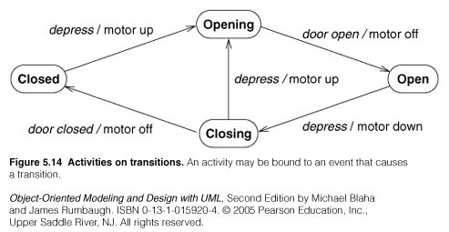
3. Entry and Exit Activities: Examples

Slide 34
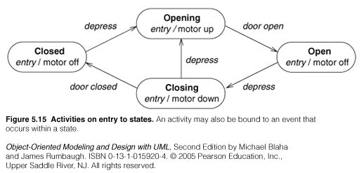
Examples

Slide 35
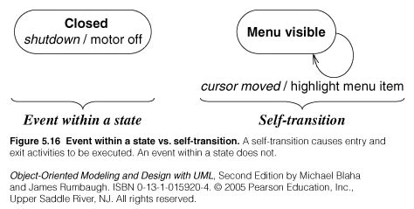
Examples

Slide 36
4.Completion Transition
5.Sending Signals
- send target.S(attributes)

Slide 37
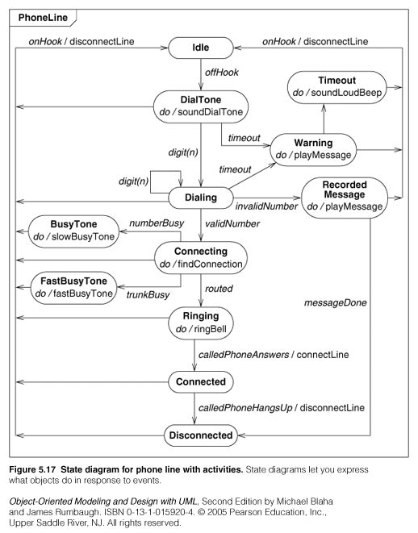
Case study

Slide 38
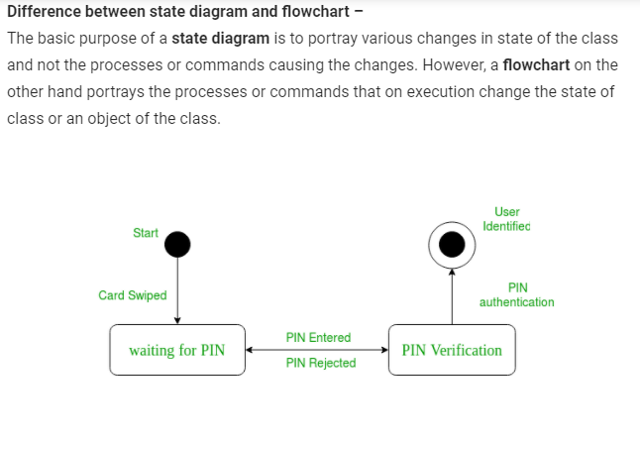

Slide 39
Advanced State Modeling:
->Problems with Flat state diagrams

Slide 40
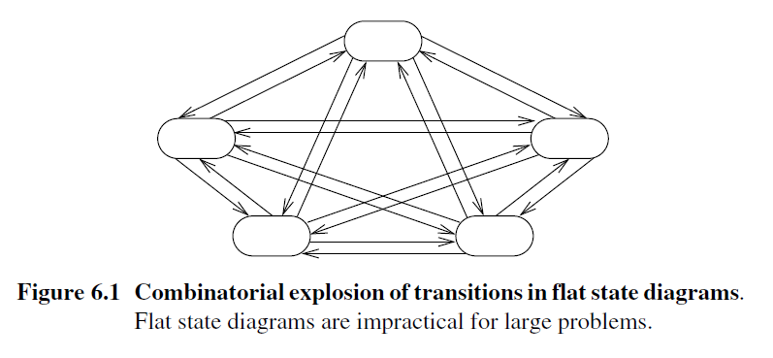

Slide 41
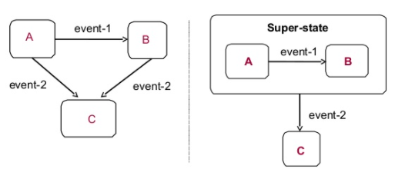

NESTED STATE DIAGRAM

Slide 42
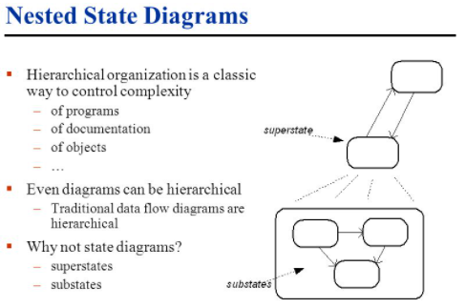

Slide 43
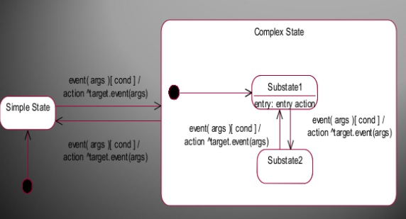

Slide 44
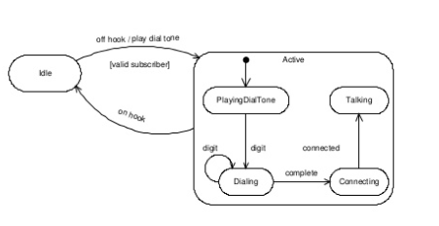

Slide 45
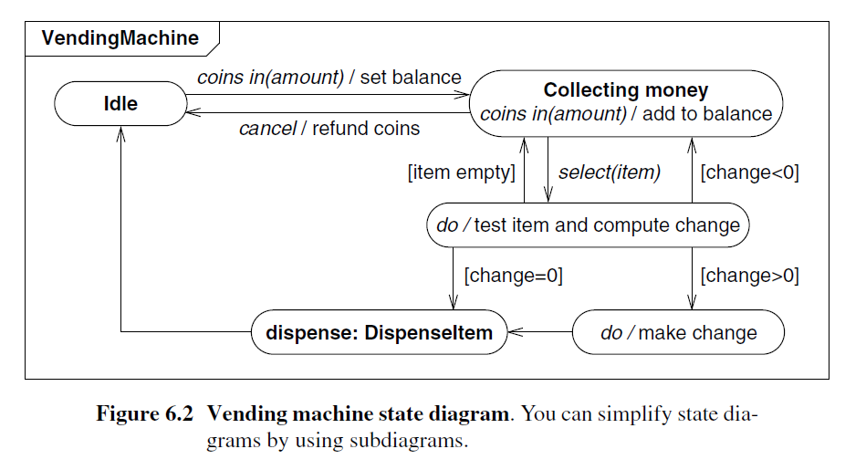
Expanding States

Slide 46
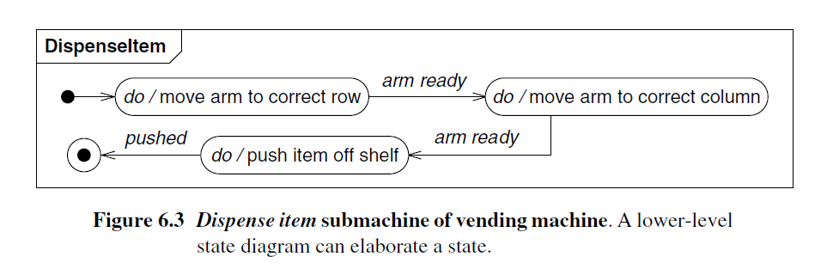

Slide 47
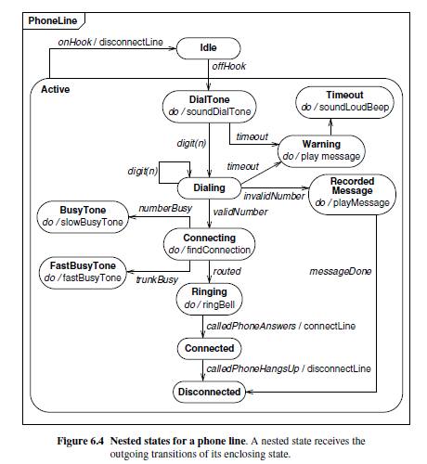
Nested States: Example – Phone line

Slide 48
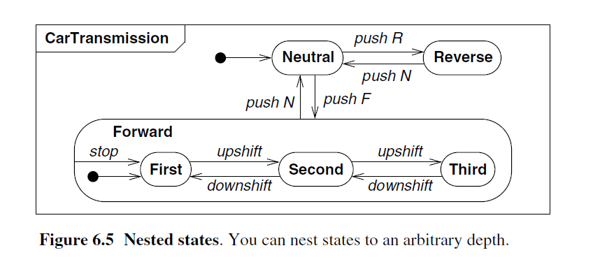
Example: Car Transmission

